Slide 1
Controlled ITS & CausalImpact

Slide 2
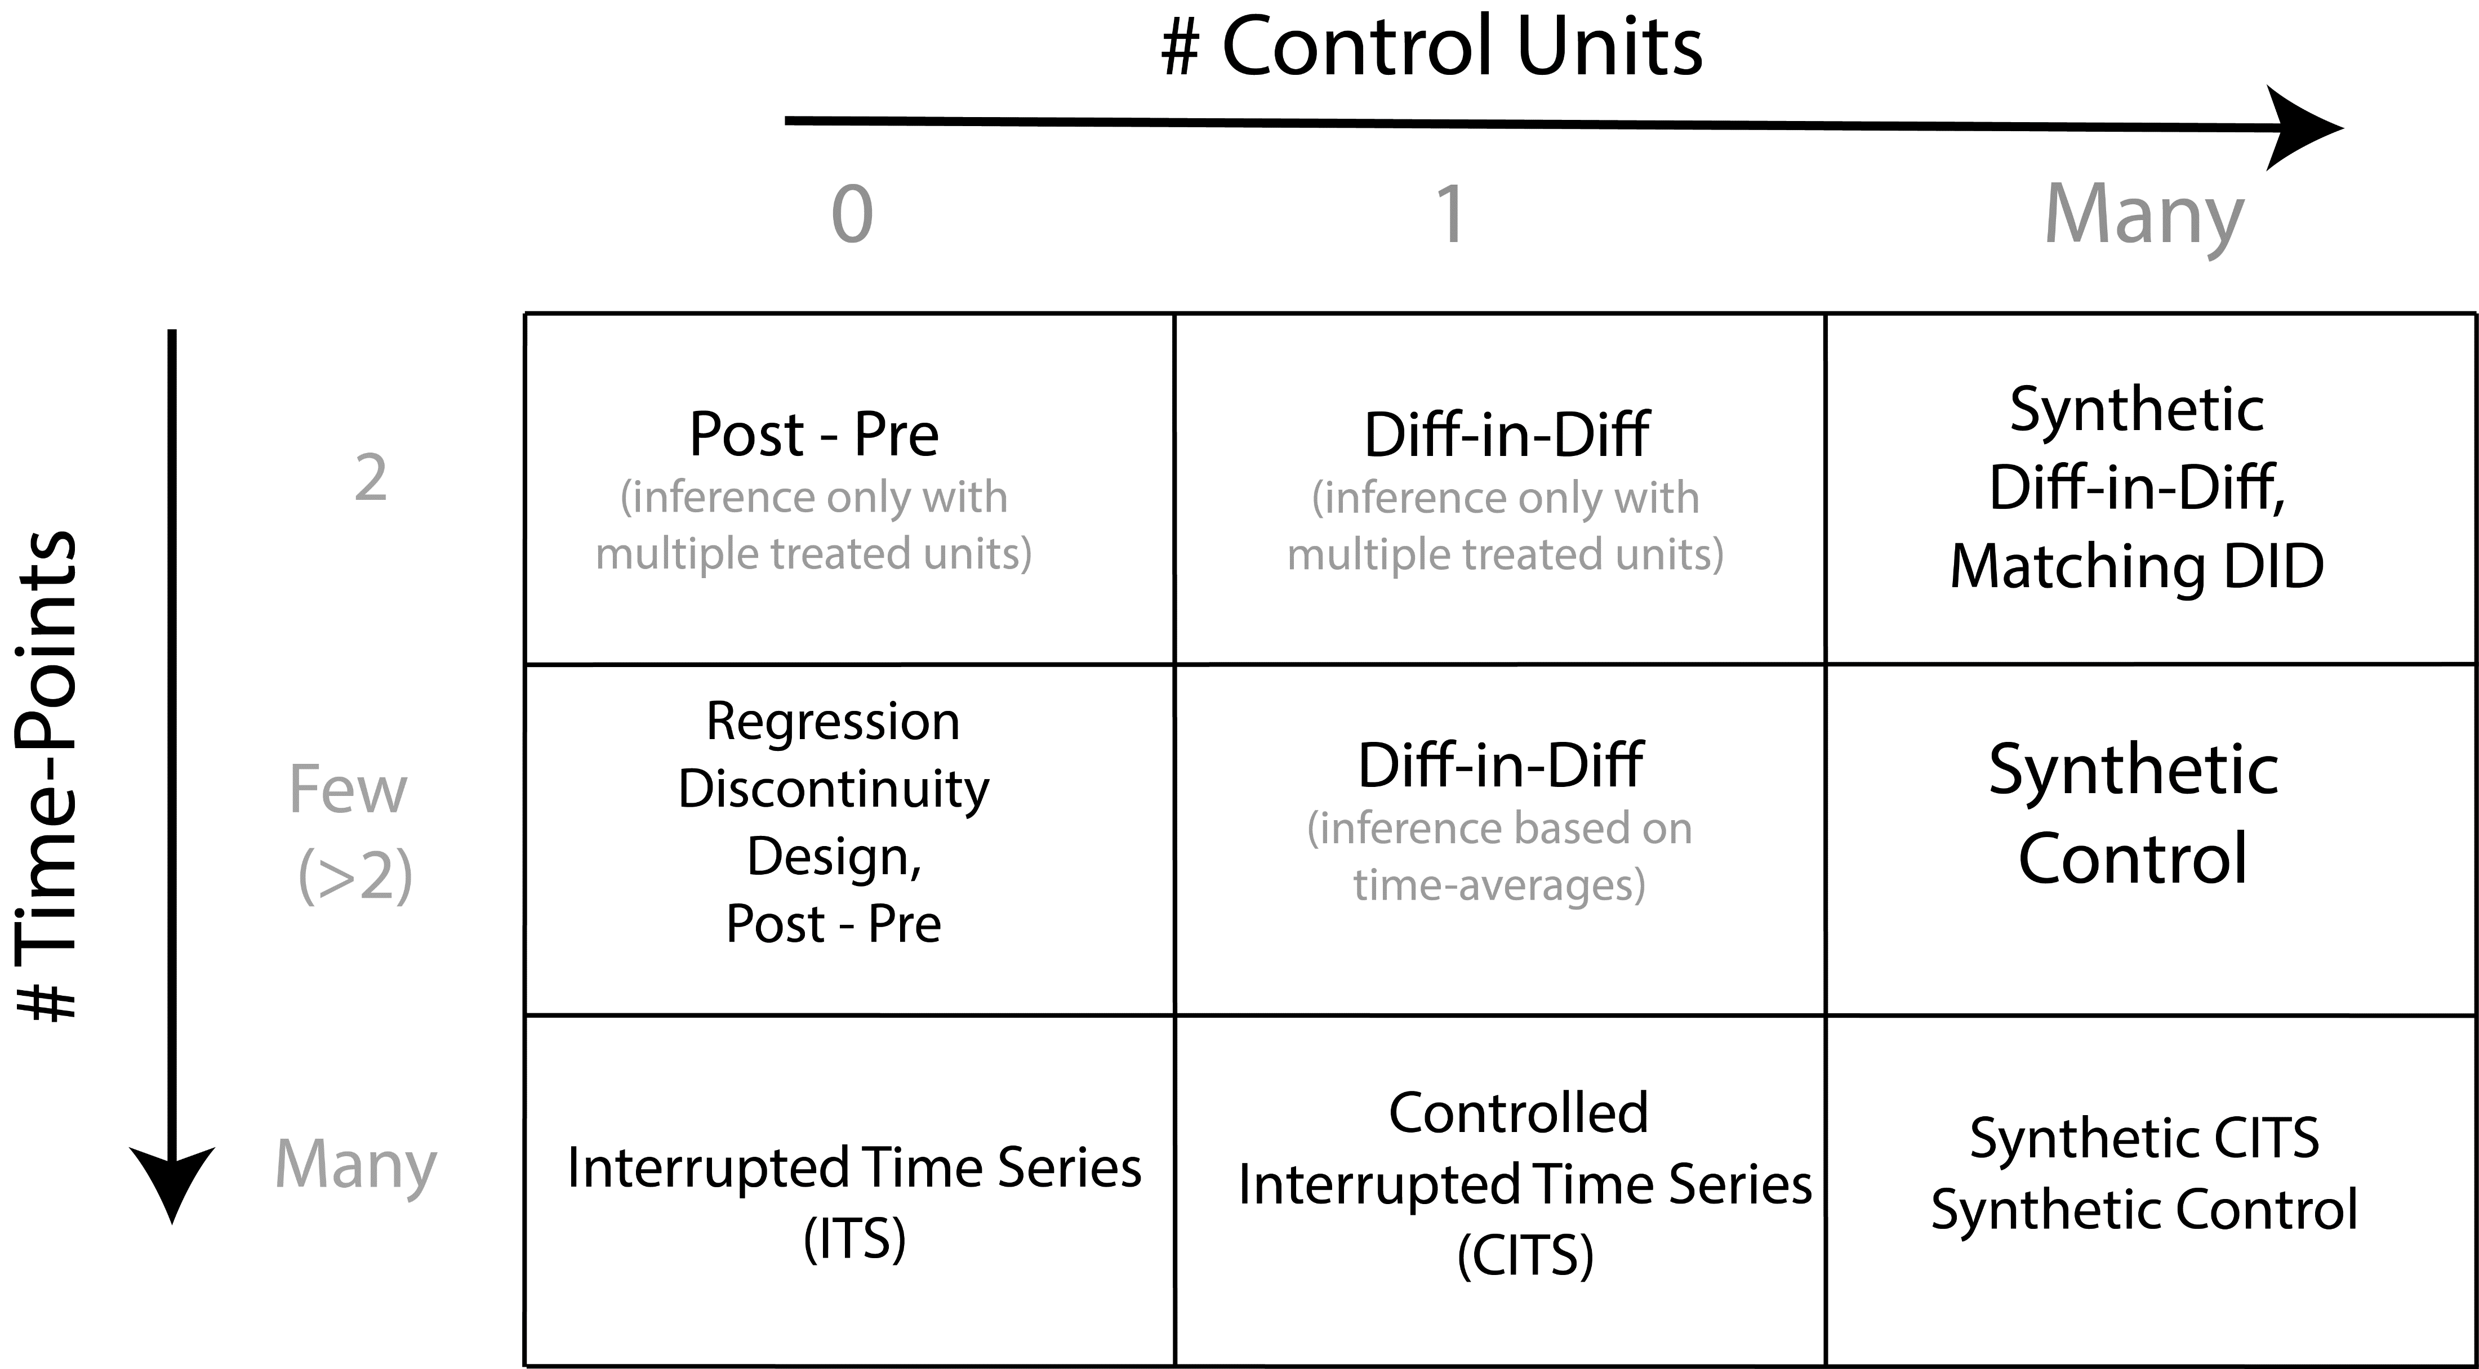

Slide 3
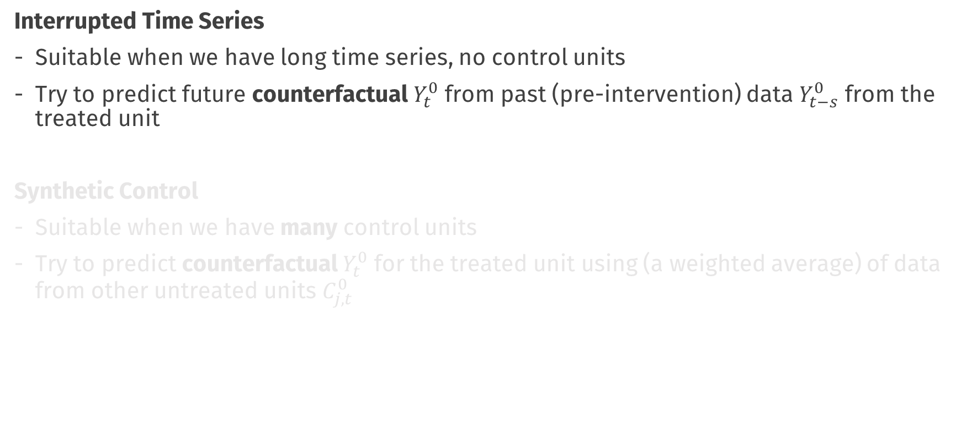
So far…
Interrupted Time Series
Suitable when we have long time series, no control units
Try to predict future counterfactual $Y_{t}^{0}$ from past (pre-intervention) data $Y_{t−s}^{0}$ from the treated unit
Synthetic Control
Suitable when we have many control units
Try to predict counterfactual $Y_{t}^{0}$ for the treated unit using (a weighted average) of data from other untreated units $C_{j, t}^{0}$

Slide 4
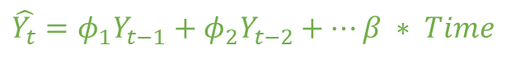
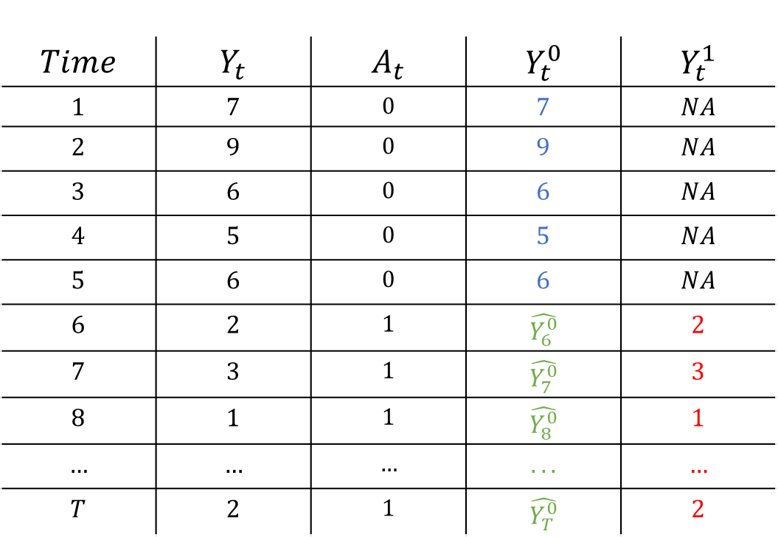

Interrupted Time Series
$$Time$$ | $$Y_{t}$$ | $$A_{t}$$ | $$Y_{t}^{0}$$ | $$Y_{t}^{1}$$
$$1$$ | $$7$$ | $$0$$ | $$7$$ | $$NA$$
$$2$$ | $$9$$ | $$0$$ | $$9$$ | $$NA$$
$$3$$ | $$6$$ | $$0$$ | $$6$$ | $$NA$$
$$4$$ | $$5$$ | $$0$$ | $$5$$ | $$NA$$
$$5$$ | $$6$$ | $$0$$ | $$6$$ | $$NA$$
$$6$$ | $$2$$ | $$1$$ | $$\hat{Y_{6}^{0}}$$ | $$2$$
$$7$$ | $$3$$ | $$1$$ | $$\hat{Y_{7}^{0}}$$ | $$3$$
$$8$$ | $$1$$ | $$1$$ | $$\hat{Y_{8}^{0}}$$ | $$1$$
$$…$$ | $$…$$ | $$…$$ | $$...$$ | $$…$$
$$T$$ | $$2$$ | $$1$$ | $$\hat{Y_{T}^{0}}$$ | $$2$$
Fit a forecasting Model
$$\hat{Y_{t}}=φ_{1}Y_{t−1}+φ_{2}Y_{t−2}+…β ∗ Time$$
Make forecasts
$$\hat{CE_{t}}=Y_{t}^{1} −\hat{Y_{t}^{0}}$$

Slide 5
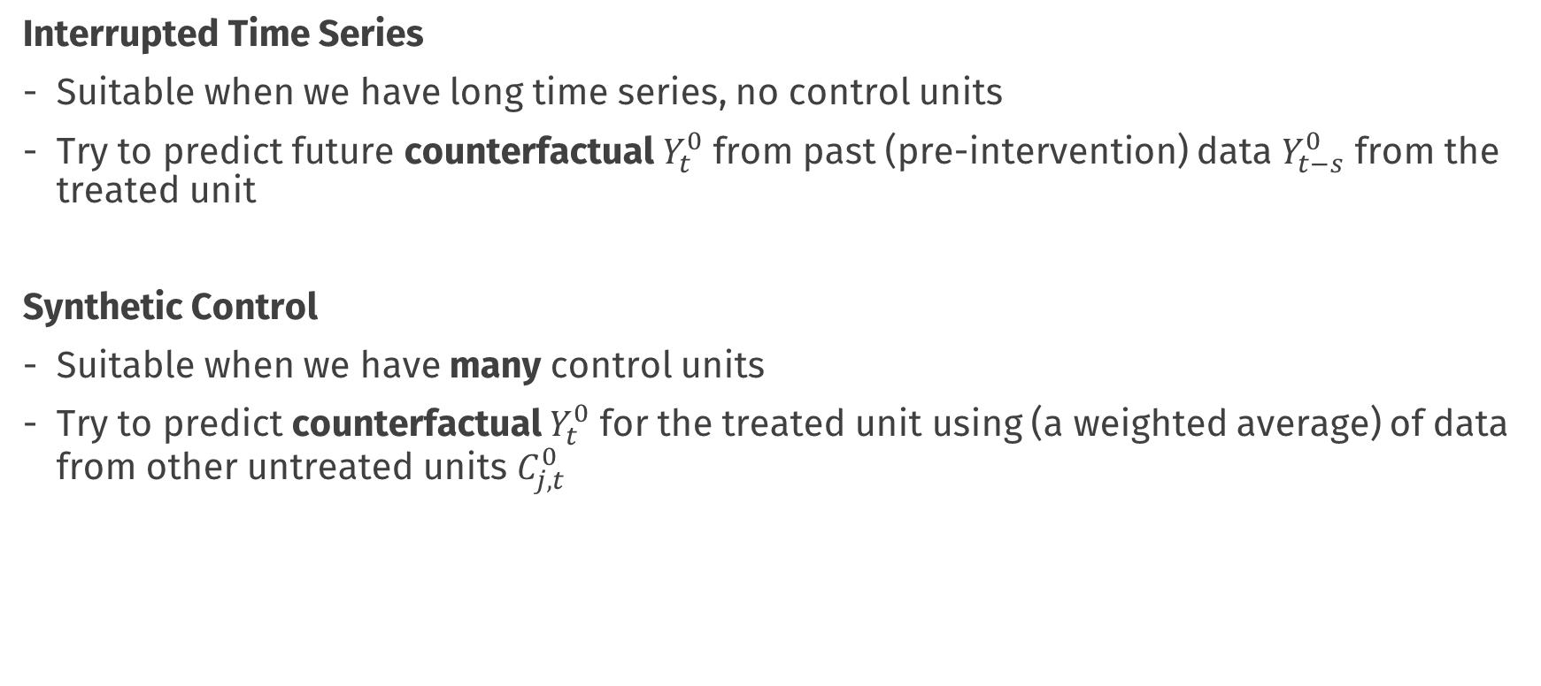
So far…
Interrupted Time Series
Suitable when we have long time series, no control units
Try to predict future counterfactual $Y_{t}^{0}$ from past (pre-intervention) data $Y_{t−s}^{0}$ from the treated unit
Synthetic Control
Suitable when we have many control units
Try to predict counterfactual $Y_{t}^{0}$ for the treated unit using (a weighted average) of data from other untreated units $C_{j, t}^{0}$

Slide 6


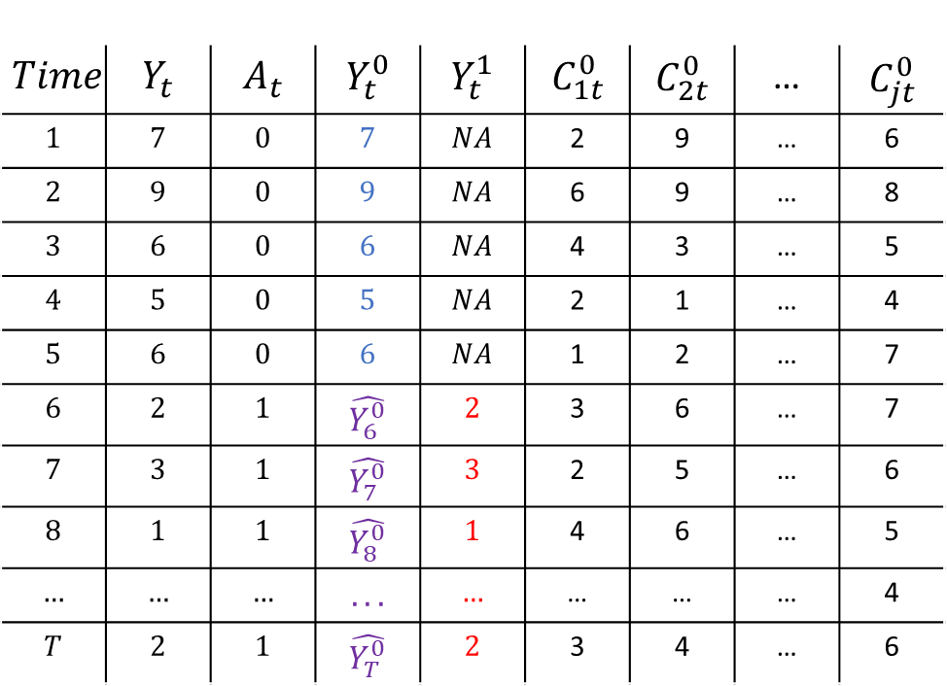



Synthetic Control
$$Time$$ | $$Y_{t}$$ | $$A_{t}$$ | $$Y_{t}^{0}$$ | $$Y_{t}^{1}$$ | $$C_{1t}^{0}$$ | $$C_{2t}^{0}$$ | … | $$C_{jt}^{0}$$
$$1$$ | $$7$$ | $$0$$ | $$7$$ | $$NA$$ | 2 | 9 | … | 6
$$2$$ | $$9$$ | $$0$$ | $$9$$ | $$NA$$ | 6 | 9 | … | 8
$$3$$ | $$6$$ | $$0$$ | $$6$$ | $$NA$$ | 4 | 3 | … | 5
$$4$$ | $$5$$ | $$0$$ | $$5$$ | $$NA$$ | 2 | 1 | … | 4
$$5$$ | $$6$$ | $$0$$ | $$6$$ | $$NA$$ | 1 | 2 | … | 7
$$6$$ | $$2$$ | $$1$$ | $$\hat{Y_{6}^{0}}$$ | $$2$$ | 3 | 6 | … | 7
$$7$$ | $$3$$ | $$1$$ | $$\hat{Y_{7}^{0}}$$ | $$3$$ | 2 | 5 | … | 6
$$8$$ | $$1$$ | $$1$$ | $$\hat{Y_{8}^{0}}$$ | $$1$$ | 4 | 6 | … | 5
$$…$$ | $$…$$ | $$…$$ | $$...$$ | $$…$$ | … | … | … | 4
$$T$$ | $$2$$ | $$1$$ | $$\hat{Y_{T}^{0}}$$ | $$2$$ | 3 | 4 | … | 6
Estimate Weights
$$Y_{t}= \sum_{j=1}^{J}{\hat{w_{j}}C_{jt}}$$
$$t<T_{0}$$
$$\hat{Y_{t}^{0}}= \sum_{j=1}^{J}{\hat{w_{j}}C_{jt}}$$
$$t>T_{0}$$
Impute counterfactual
$$\hat{CE_{t}}=Y_{t}^{1} −\hat{Y_{t}^{0}}$$

Slide 7
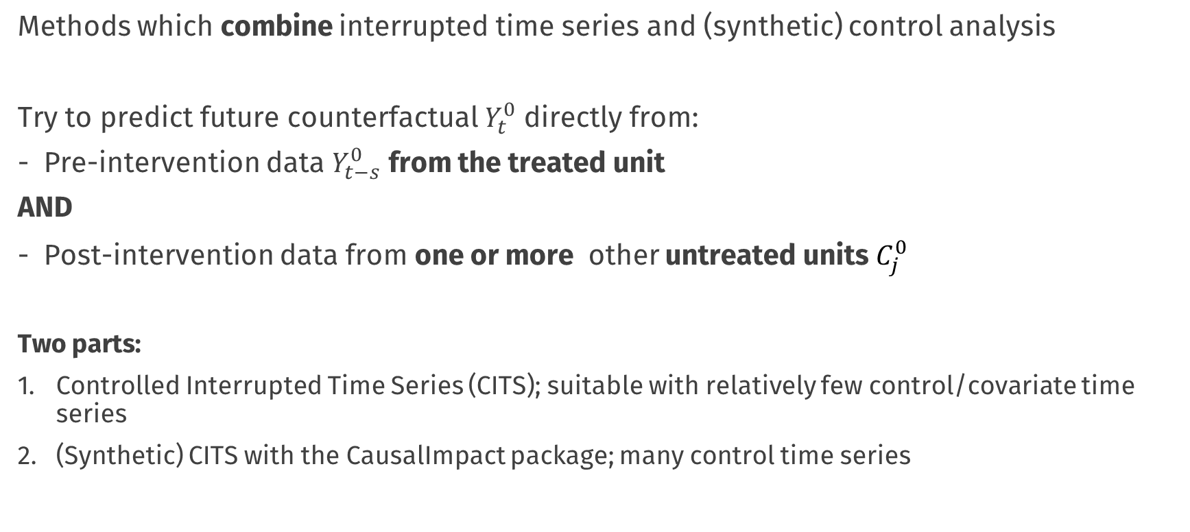
This Lecture
Methods which combine interrupted time series and (synthetic) control analysis
Try to predict future counterfactual $Y_{t}^{0}$ directly from:
Pre-intervention data $Y_{t−s}^{0}$ from the treated unit
AND
Post-intervention data from one or more other untreated units $C_{j}^{0}$
Two parts:
Controlled Interrupted Time Series (CITS); suitable with relatively few control/covariate time series
(Synthetic) CITS with the CausalImpact package; many control time series

Slide 9
Controlled Interrupted Time Series
An extension of Interrupted Time Series when we have access to one or more control time series
Typically observations of the same process, for a different unit, which is correlated with (i.e. predictive of) the target time series, but which does not experience the intervention
Similar criteria as the synthetic control and DiD method “control” units
Basic Idea:
Build a time series / forecasting model, but include control time series as contemporaneous (same-time-moment) predictors

Slide 10
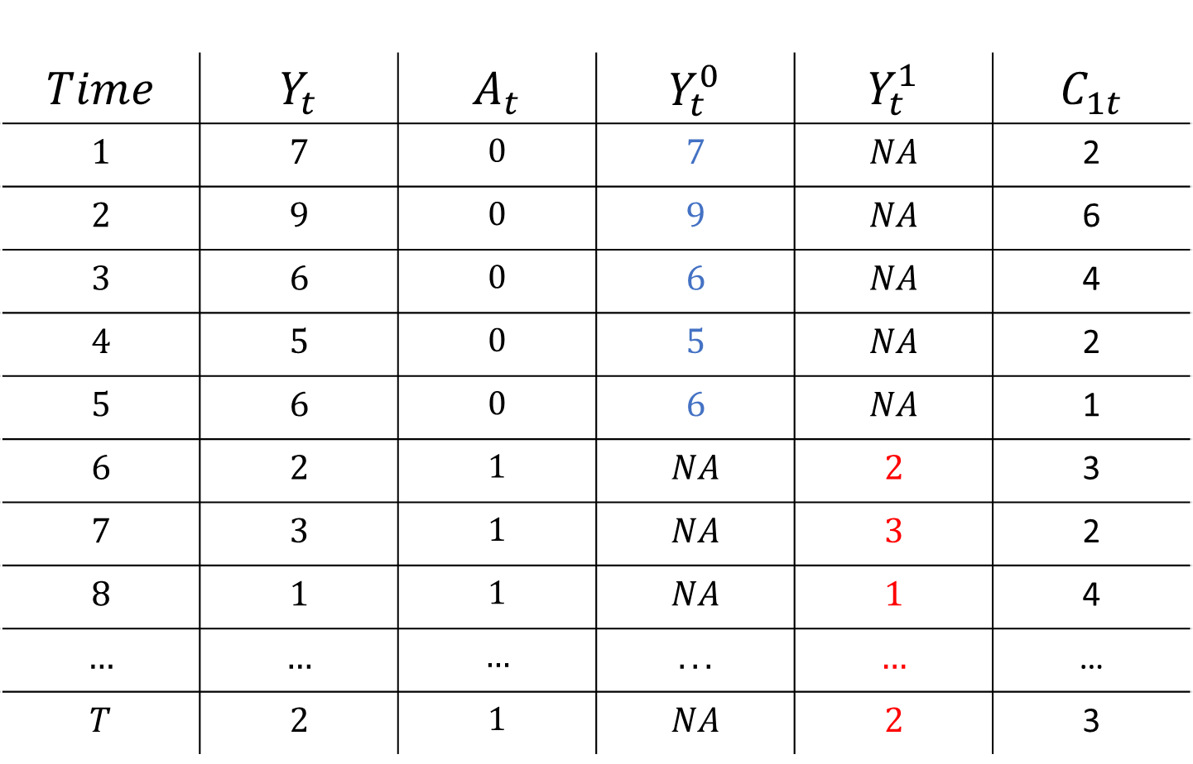
$$Time$$ | $$Y_{t}$$ | $$A_{t}$$ | $$Y_{t}^{0}$$ | $$Y_{t}^{1}$$ | $$C_{1t}$$
$$1$$ | $$7$$ | $$0$$ | $$7$$ | $$NA$$ | 2
$$2$$ | $$9$$ | $$0$$ | $$9$$ | $$NA$$ | 6
$$3$$ | $$6$$ | $$0$$ | $$6$$ | $$NA$$ | 4
$$4$$ | $$5$$ | $$0$$ | $$5$$ | $$NA$$ | 2
$$5$$ | $$6$$ | $$0$$ | $$6$$ | $$NA$$ | 1
$$6$$ | $$2$$ | $$1$$ | $$NA$$ | $$2$$ | 3
$$7$$ | $$3$$ | $$1$$ | $$NA$$ | $$3$$ | 2
$$8$$ | $$1$$ | $$1$$ | $$NA$$ | $$1$$ | 4
$$…$$ | $$…$$ | $$…$$ | $$...$$ | $$…$$ | …
$$T$$ | $$2$$ | $$1$$ | $$NA$$ | $$2$$ | 3

Slide 11
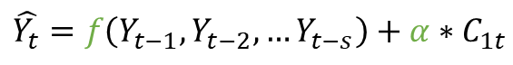
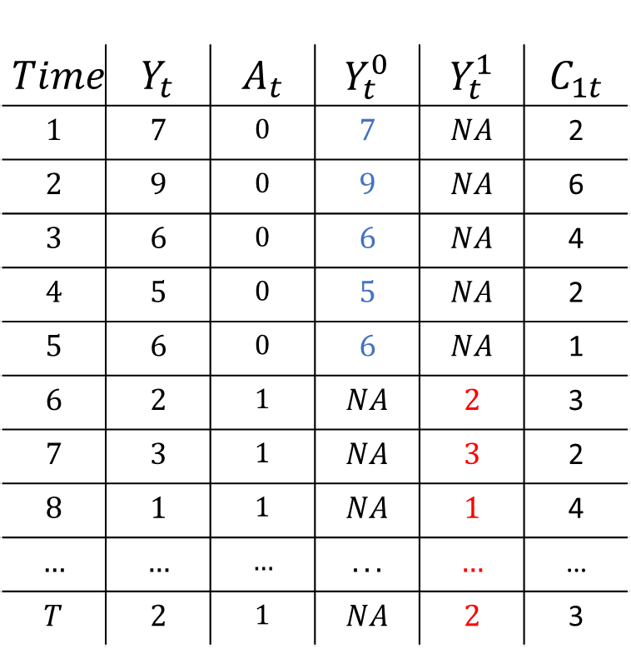
Controlled Interrupted Time Series
$$Time$$ | $$Y_{t}$$ | $$A_{t}$$ | $$Y_{t}^{0}$$ | $$Y_{t}^{1}$$ | $$C_{1t}$$
$$1$$ | $$7$$ | $$0$$ | $$7$$ | $$NA$$ | 2
$$2$$ | $$9$$ | $$0$$ | $$9$$ | $$NA$$ | 6
$$3$$ | $$6$$ | $$0$$ | $$6$$ | $$NA$$ | 4
$$4$$ | $$5$$ | $$0$$ | $$5$$ | $$NA$$ | 2
$$5$$ | $$6$$ | $$0$$ | $$6$$ | $$NA$$ | 1
$$6$$ | $$2$$ | $$1$$ | $$NA$$ | $$2$$ | 3
$$7$$ | $$3$$ | $$1$$ | $$NA$$ | $$3$$ | 2
$$8$$ | $$1$$ | $$1$$ | $$NA$$ | $$1$$ | 4
$$…$$ | $$…$$ | $$…$$ | $$...$$ | $$…$$ | …
$$T$$ | $$2$$ | $$1$$ | $$NA$$ | $$2$$ | 3
Fit a forecasting model
C as time-varying predictor
$$\hat{Y_{t}}=f\left(Y_{t−1}, Y_{t−2}, …Y_{t−s}\right)+α∗C_{1t}$$

Slide 12
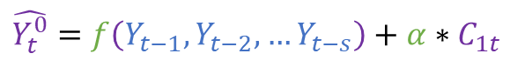
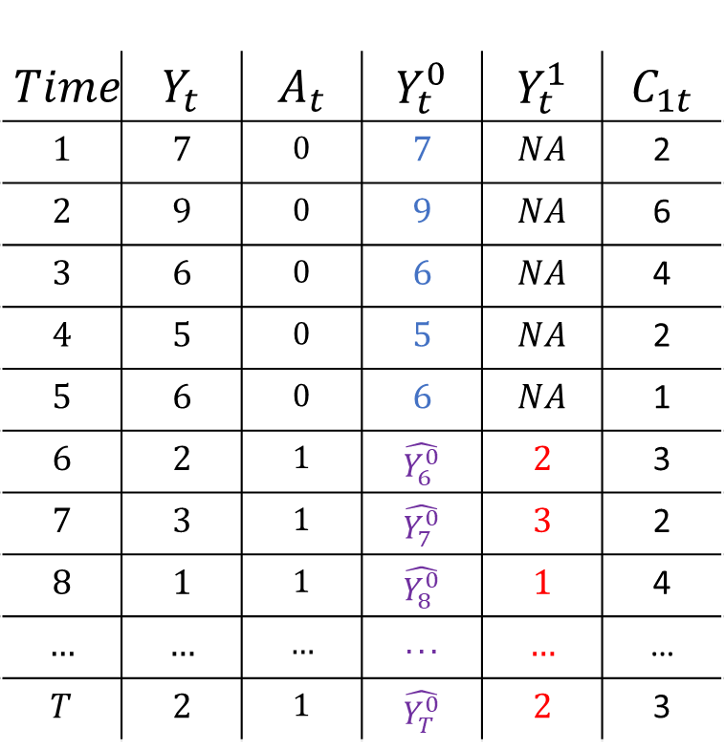
Controlled Interrupted Time Series
$$Time$$ | $$Y_{t}$$ | $$A_{t}$$ | $$Y_{t}^{0}$$ | $$Y_{t}^{1}$$ | $$C_{1t}$$
$$1$$ | $$7$$ | $$0$$ | $$7$$ | $$NA$$ | 2
$$2$$ | $$9$$ | $$0$$ | $$9$$ | $$NA$$ | 6
$$3$$ | $$6$$ | $$0$$ | $$6$$ | $$NA$$ | 4
$$4$$ | $$5$$ | $$0$$ | $$5$$ | $$NA$$ | 2
$$5$$ | $$6$$ | $$0$$ | $$6$$ | $$NA$$ | 1
$$6$$ | $$2$$ | $$1$$ | $$\hat{Y_{6}^{0}}$$ | $$2$$ | 3
$$7$$ | $$3$$ | $$1$$ | $$\hat{Y_{7}^{0}}$$ | $$3$$ | 2
$$8$$ | $$1$$ | $$1$$ | $$\hat{Y_{8}^{0}}$$ | $$1$$ | 4
$$…$$ | $$…$$ | $$…$$ | $$...$$ | $$…$$ | …
$$T$$ | $$2$$ | $$1$$ | $$\hat{Y_{T}^{0}}$$ | $$2$$ | 3
Fit a forecasting model
C as time-varying predictor
$$\hat{Y_{t}}=f\left(Y_{t−1}, Y_{t−2}, …Y_{t−s}\right)+α∗C_{1t}$$
$$\hat{Y_{t}^{0}}=f\left(Y_{t−1}, Y_{t−2}, …Y_{t−s}\right)+α∗C_{1t}$$
Impute counterfactual

Slide 13
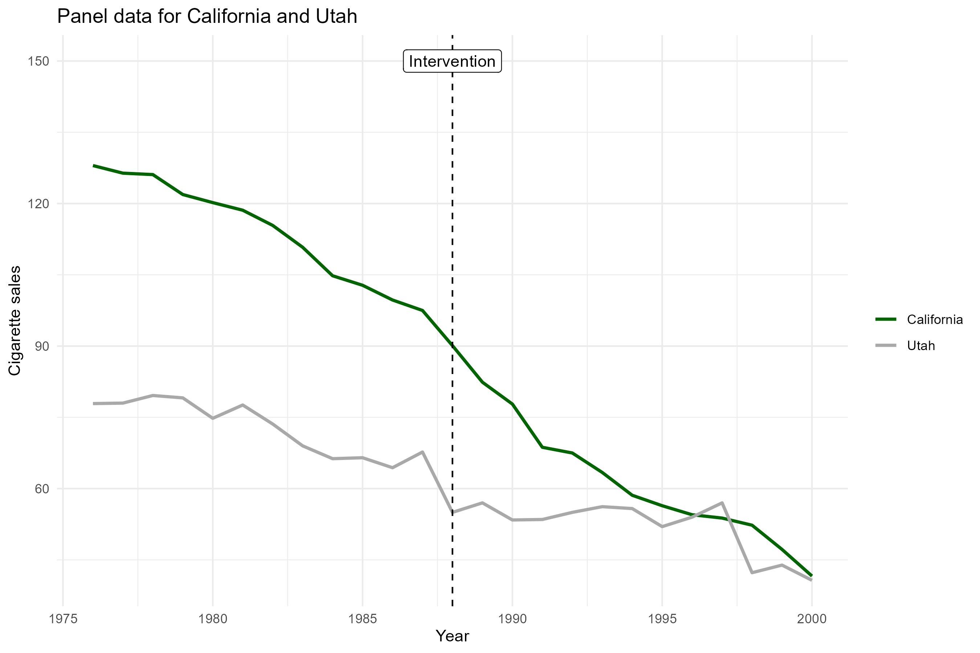

Slide 14
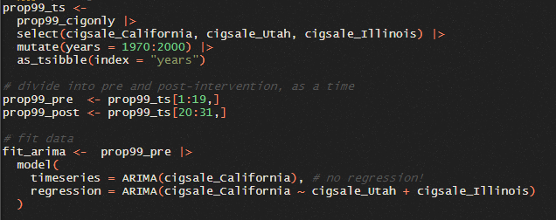
Controlled Interrupted Time Series

Slide 15
Key Assumptions
This method inherits the key assumptions of ITS and Synthetic Control
Do you remember what they are?
No interference: California receiving treatment does not effect the potential outcome value of Utah
Choose an appropriate time series model (!!!)
Time-invariant relationships: Some form of “model invariance” over time
(i.e. changes are attributable only to the intervention)
Often phrased as some form of “stationarity” assumption

Slide 16
But what if we have many control time series? AND a long time-series pre treatment?
- Many potential states who did not have a law change
- Many different “products” that did not receive a new type of advertisement
Same basic principles apply, however, you may need to be clever in statistical terms:
allow a general enough model to capture complex dependencies,
try to avoid overfitting by keeping the end model simple

Slide 17
CausalImpact

Slide 19
CausalImpact
CausalImpact is an R and python packaged developed by Google
Performs what could be described as “Synthetic Controlled Interrupted Time Series”
Basic Idea:
Exactly the same principles as Controlled ITS
The model has a time-forward forecasting part and a “control unit” regression part
Behind-the-scenes uses Bayesian estimation to build the forecasting model
A subset of units are included in the control unit part, with different weights; similar to a synthetic control analysis (but differing in many other details)
- CausalImpact package takes care of model building + selection behind the scenes (!)

Slide 20
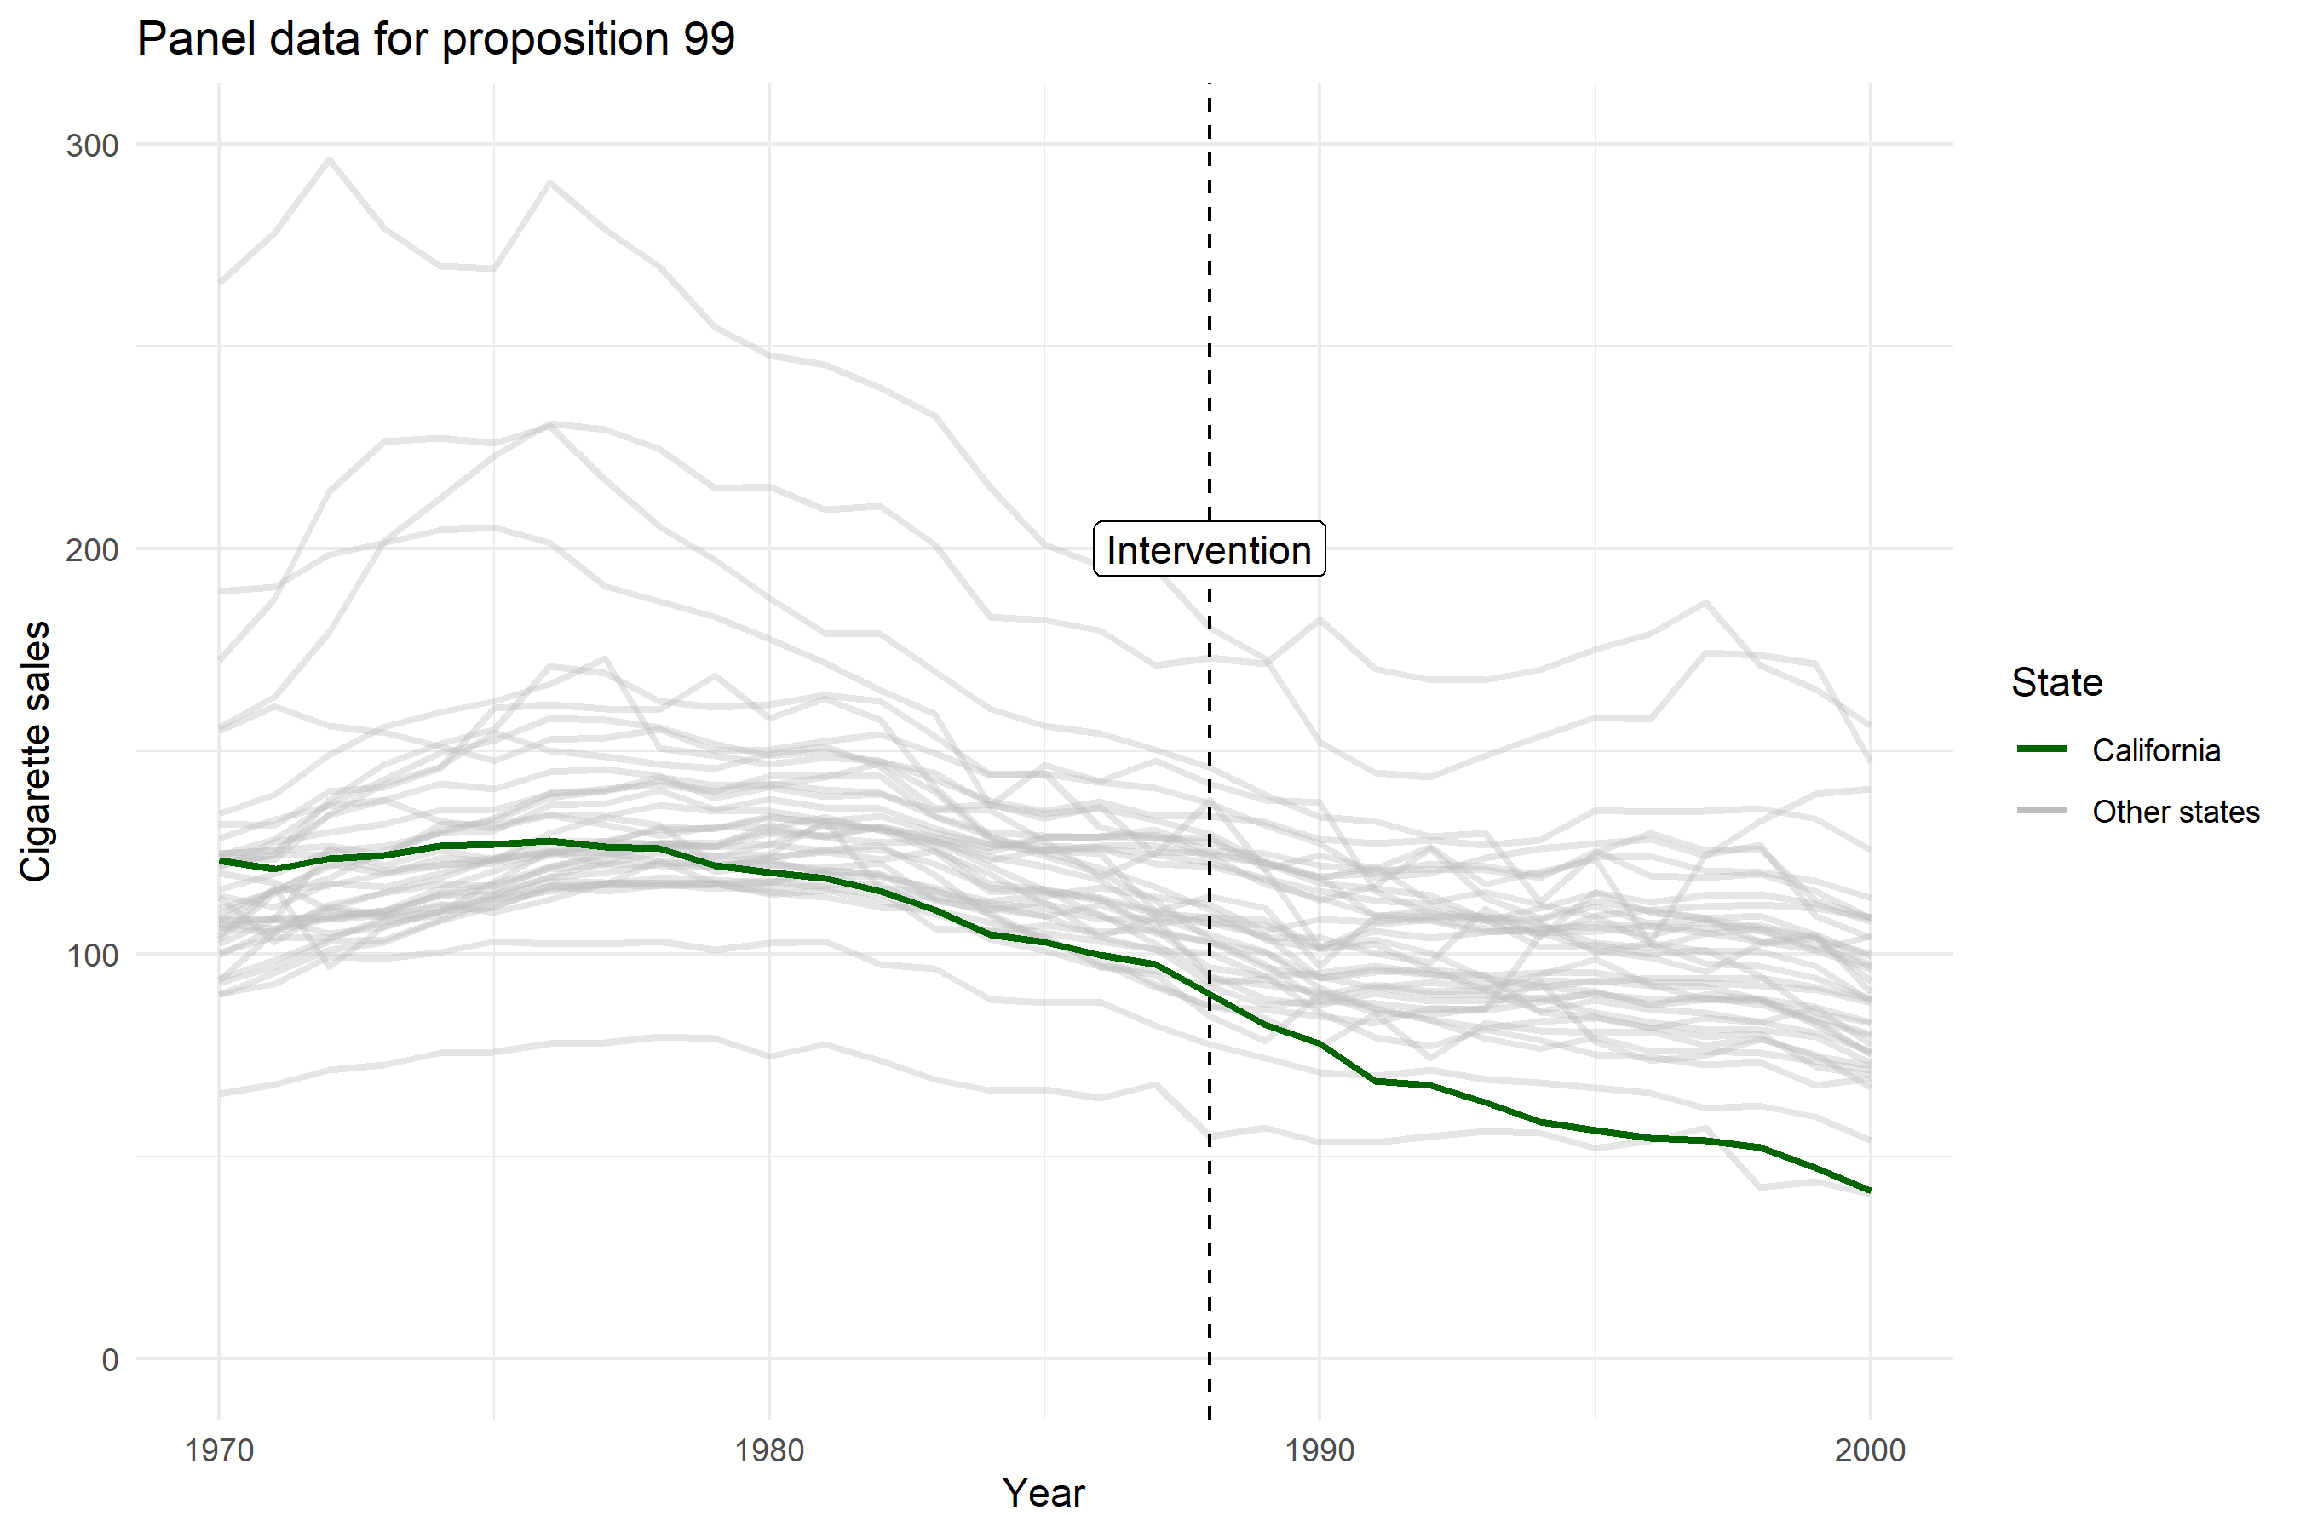

Slide 21
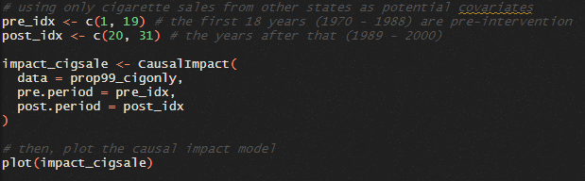
CausalImpact in action

Slide 22
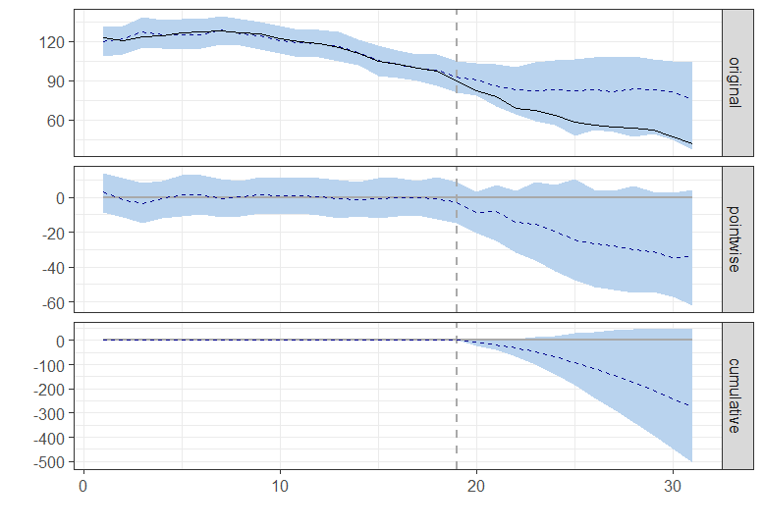
Observed
Predicted (counterfactual)
Causal Effect estimate at each t
Sum of causal effect estimates at all previous time points

Slide 23
Observed
Predicted (counterfactual)
Causal Effect estimate at each t
Sum of causal effect estimates at all previous time points

Slide 24
Behind the scenes
CausalImpact uses Bayesian Estimation
Bayesian structural time-series models (bsts package in R)
Control units are “chosen” by using spike-and-slab priors
Bayesian estimation means it iss easy to quantify uncertainty (i.e. get confidence intervals) around estimates of the causal effect, and other interesting metrics related to that

Slide 25
Behind the scenes
Beware: Bayesian estimation requires the user to specify many priors
Controls things like model complexity and which part of the model (forecasting vs control units) will be dominant
These choices are hidden from the user with defaults.
This is nice when you want to get something running, but in practice you really need to investigate how sensitive your conclusions are to sometime arbitrary choices, like small changes in these specifications
In general: the package hides many model specification and selection choices from you. Good for usability, bad for critical evaluation. Always check how robust your estimates are!

Slide 26
Practical: fpp3, causalimpact
Work in your groups!
Take a break from 16:15 to 16:30

Slide 27
Break

